Slide 1



Slide 2

The Murky Swamp…

Slide 3
The Arizona Partnership for Immunization
Public/private partnership working together to sustain an immunization program for all Arizonan's across the lifespan
20 year partnership to create immunization programs like our state registry and the current billing program
3 paid FTE TAPI employees until ARRA funding able to expand to 9 FTE, 4 contractors and 2 PhD interns to study sustainability

Slide 4
Medical leadership
TAPI Board of Directors
State Public Health Directors
County Public Health Directors
Medical Director of AHCCCS (AZ Medicaid)
Medical Directors of private and public insurance plans
Medical leadership from local universities and colleges
Members of private medical associations

Slide 5
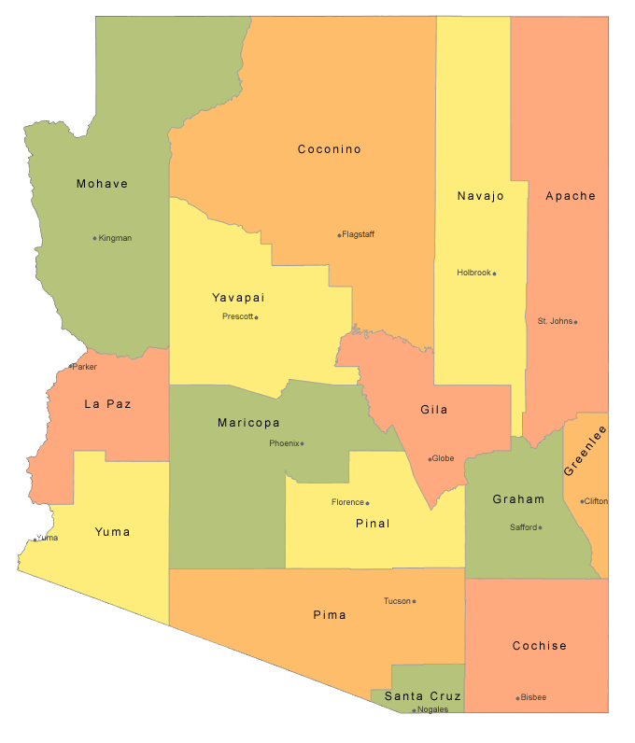
Arizona Public Health
15 county health departments that range in population of a few thousand to 4 million
Most had never billed for immunization services including the largest Maricopa County
With 7 immunization nurses for 4 million people Maricopa didn’t have the resources to develop a new program

Slide 6
Arizona Immunization Budget
Several years ago our state immunization budget was cut from $10 million to zero
We were able to put several measures in place that prevented public clinics from having to turn kids away for recommended immunizations
We knew we need to develop some long term solutions

Slide 7
Immunization Financing System
317
State $ - NOT
AHCCCS
Uninsured
VFC
IHS
Providers
CDC
Co-pays
Kids Care
Schools
Pvt Insurance
ACA
?
FQHCs
Underinsured
ADHS
County $ - NOT
Pts
Notes:
This is how most people think the government works.

Slide 8
Starting a dialog
Presented Maricopa County data to Medical Leadership
Enlisted Medicaid
Held large Vaccine Congresses with our local AAP

Slide 9
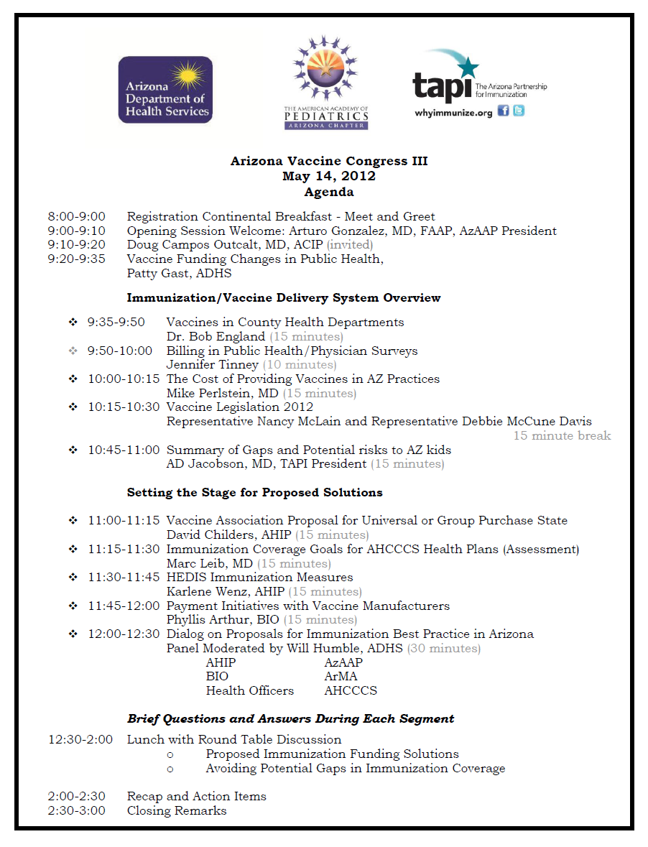
Set of recommendations for each section were identified
Billing was only one system changing idea!

Slide 10
The goal
Self sustaining billing program:
TAPI agreed to take on the project with no initial funding for a percentage of what we would collect.
Our hope:
$1

Slide 11


Needs Assessment
Met with
health plans
Met with counties / define similar problems
Met with
billing vendors
Hired staff and
started sending claims

Slide 12

And we were off…
Started the dialog with partners
Collected data
Contracted with plans
Worked on policies
Developed a workflow
Processed the claims
Searched for funding

Slide 13
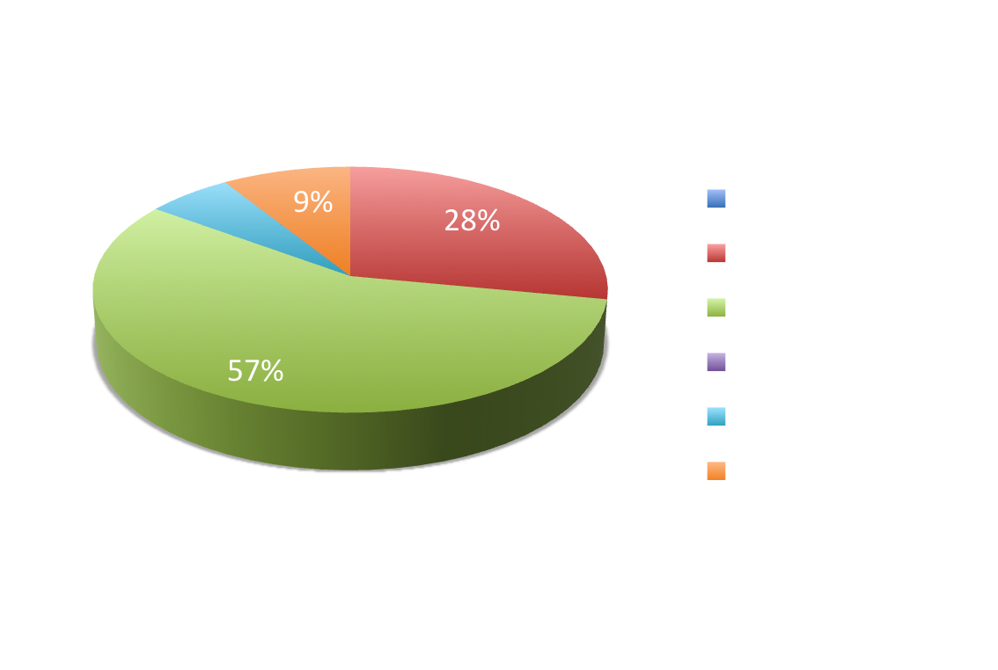
Collected Data
Who uses MCDPH clinics?
70,797 patient encounters in 2009

Slide 14
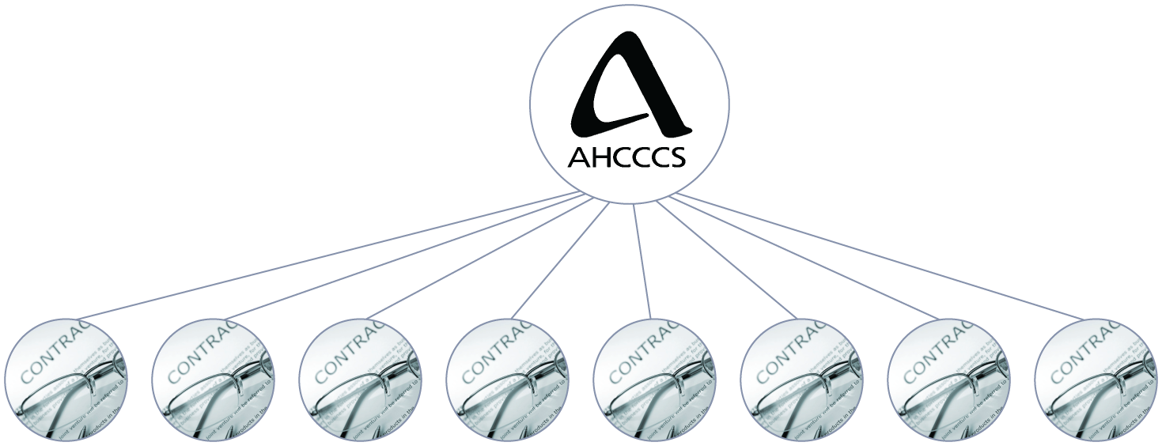
Arizona’s Medicaid System
Bridgeway
Health
APIPA
Phoenix Health Plan
Maricopa Health Plan
Mercy Care
Care 1st
Pima Health Plan
Health Choice

Slide 15
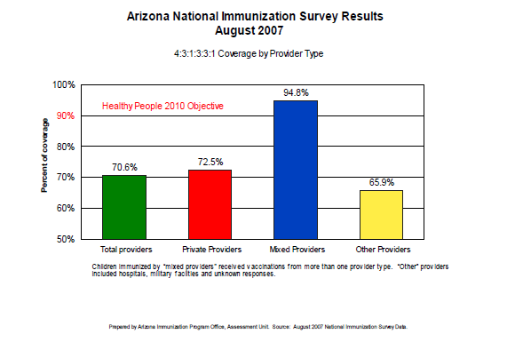

Slide 16
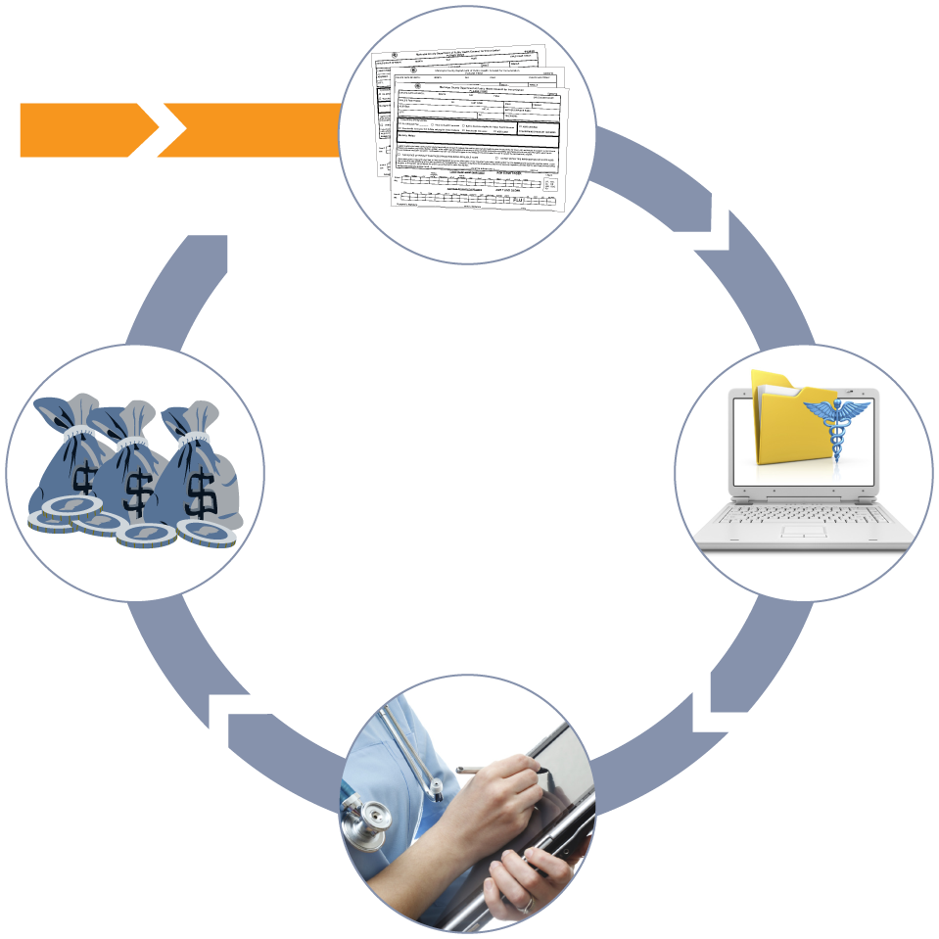
Billing Workflow
CDH
Administers vaccines
TAPI
Verifies, records and bills administration fees
TAPI
Post paid claims and reviews denied claims
Health Plans
Review the claims

Slide 17
Billing Claims
We are contracted with and bill AHCCCS health plans $15.43 for our Medicaid Admin fees . We received $10-12 per shot.
We started contracting and billing private plans and we receive anywhere from $4 per shot up to $61 per shot for an admin fee.

Slide 18
The 5 Top Private insurance plans in Arizona
Health Plan | Arizona Enrollment
Blue Cross Blue Shield | 1,096,644
United Health Care /PacifiCare | 916,534
Cigna Health Care | 450,886
Aetna Health Plan | 275,387
Health Net | 149,475

Slide 19
Privately insured patients at MCDPH

Slide 20
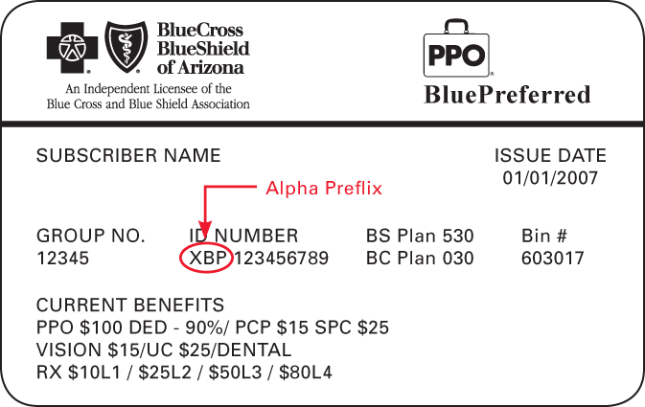
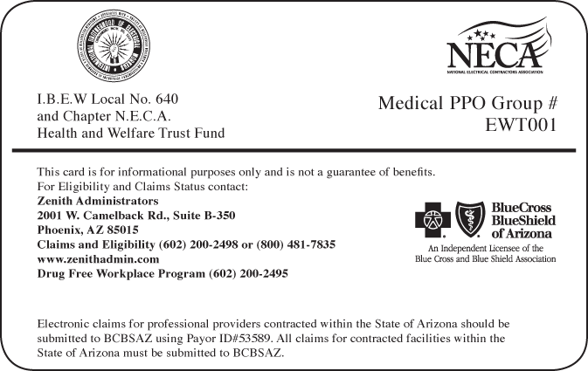

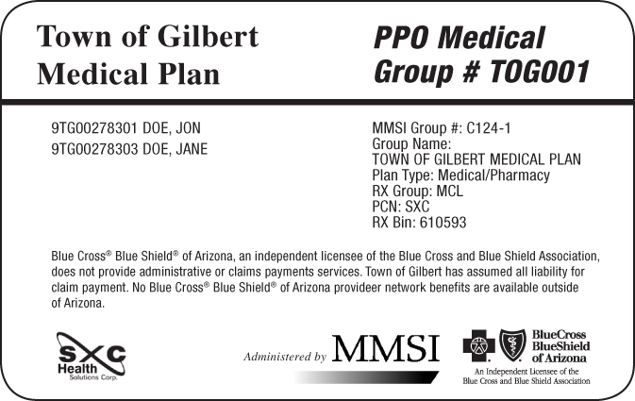
all private insurance cards are not the same…
Valid ID
Valid ID

Slide 21
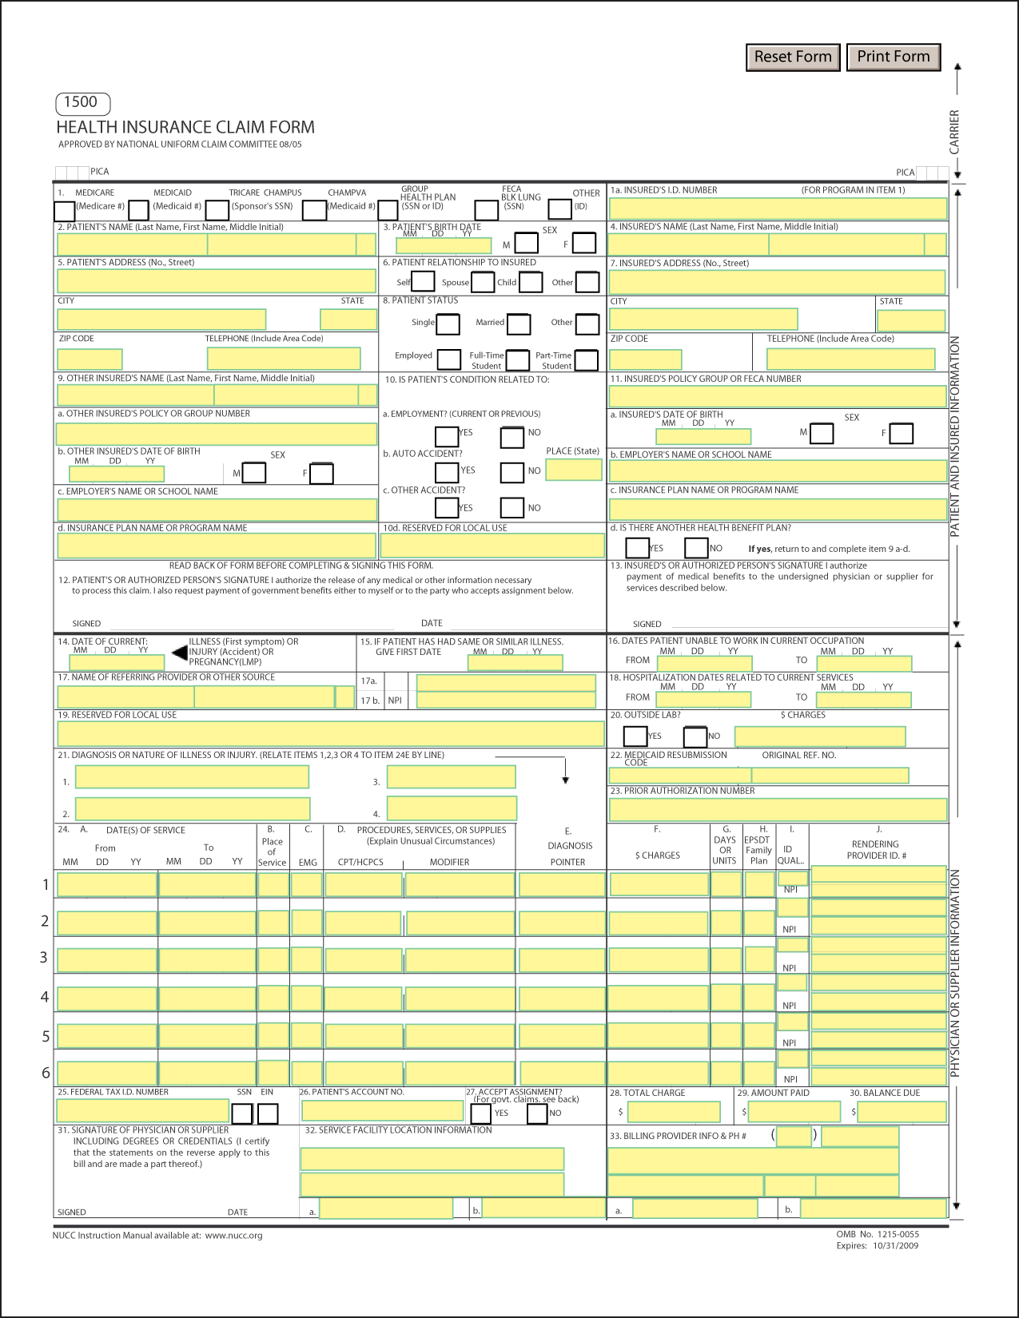
Obstacles
ID Card / AHCCCS Websites
Physicians
Need to have valid Medicaid and NPI numbers
Consent Forms
Needs to be legible and accurate
CHD
Need to have valid Medicaid and NPI numbers
Biller
Needs to have valid Medicaid and NPI numbers

Slide 22
Common Obstacles
Multiple departments in a county may use the same Tax ID
Several health departments have contracted Medical Directors
CHDs need to have the correct AHCCCS ID numbers
  provider AHCCCS ID # - allows a doctor to submit claims
  facility AHCCCS ID # - allows a clinic to submit claims
  group biller AHCCCS ID# - allows multiple locations to get checks sent to one place
Public Insurance plans must update their system to pay despite contract status
Patients/parents must provide accurate information to the clinics
Plans often pay 60-80% of the claim

Slide 23
Patient Encounters
2009
2010
$236,620
$465,503
$9,155
Total encounters:
70,797
Total encounters:
56,467

Slide 24
Buying Vaccine
  Because of the gaps in the system we are cautious about purchasing vaccine for privately insured kids at this time but we hope to make some changes:
  Third Vaccine Congress to address the issues
  Working with health plans and the Pediatric Council on introduction of legislation and alternative funding models
  Exploration of State or Federal vaccine stocks that we can pay back after reimbursement

Slide 25
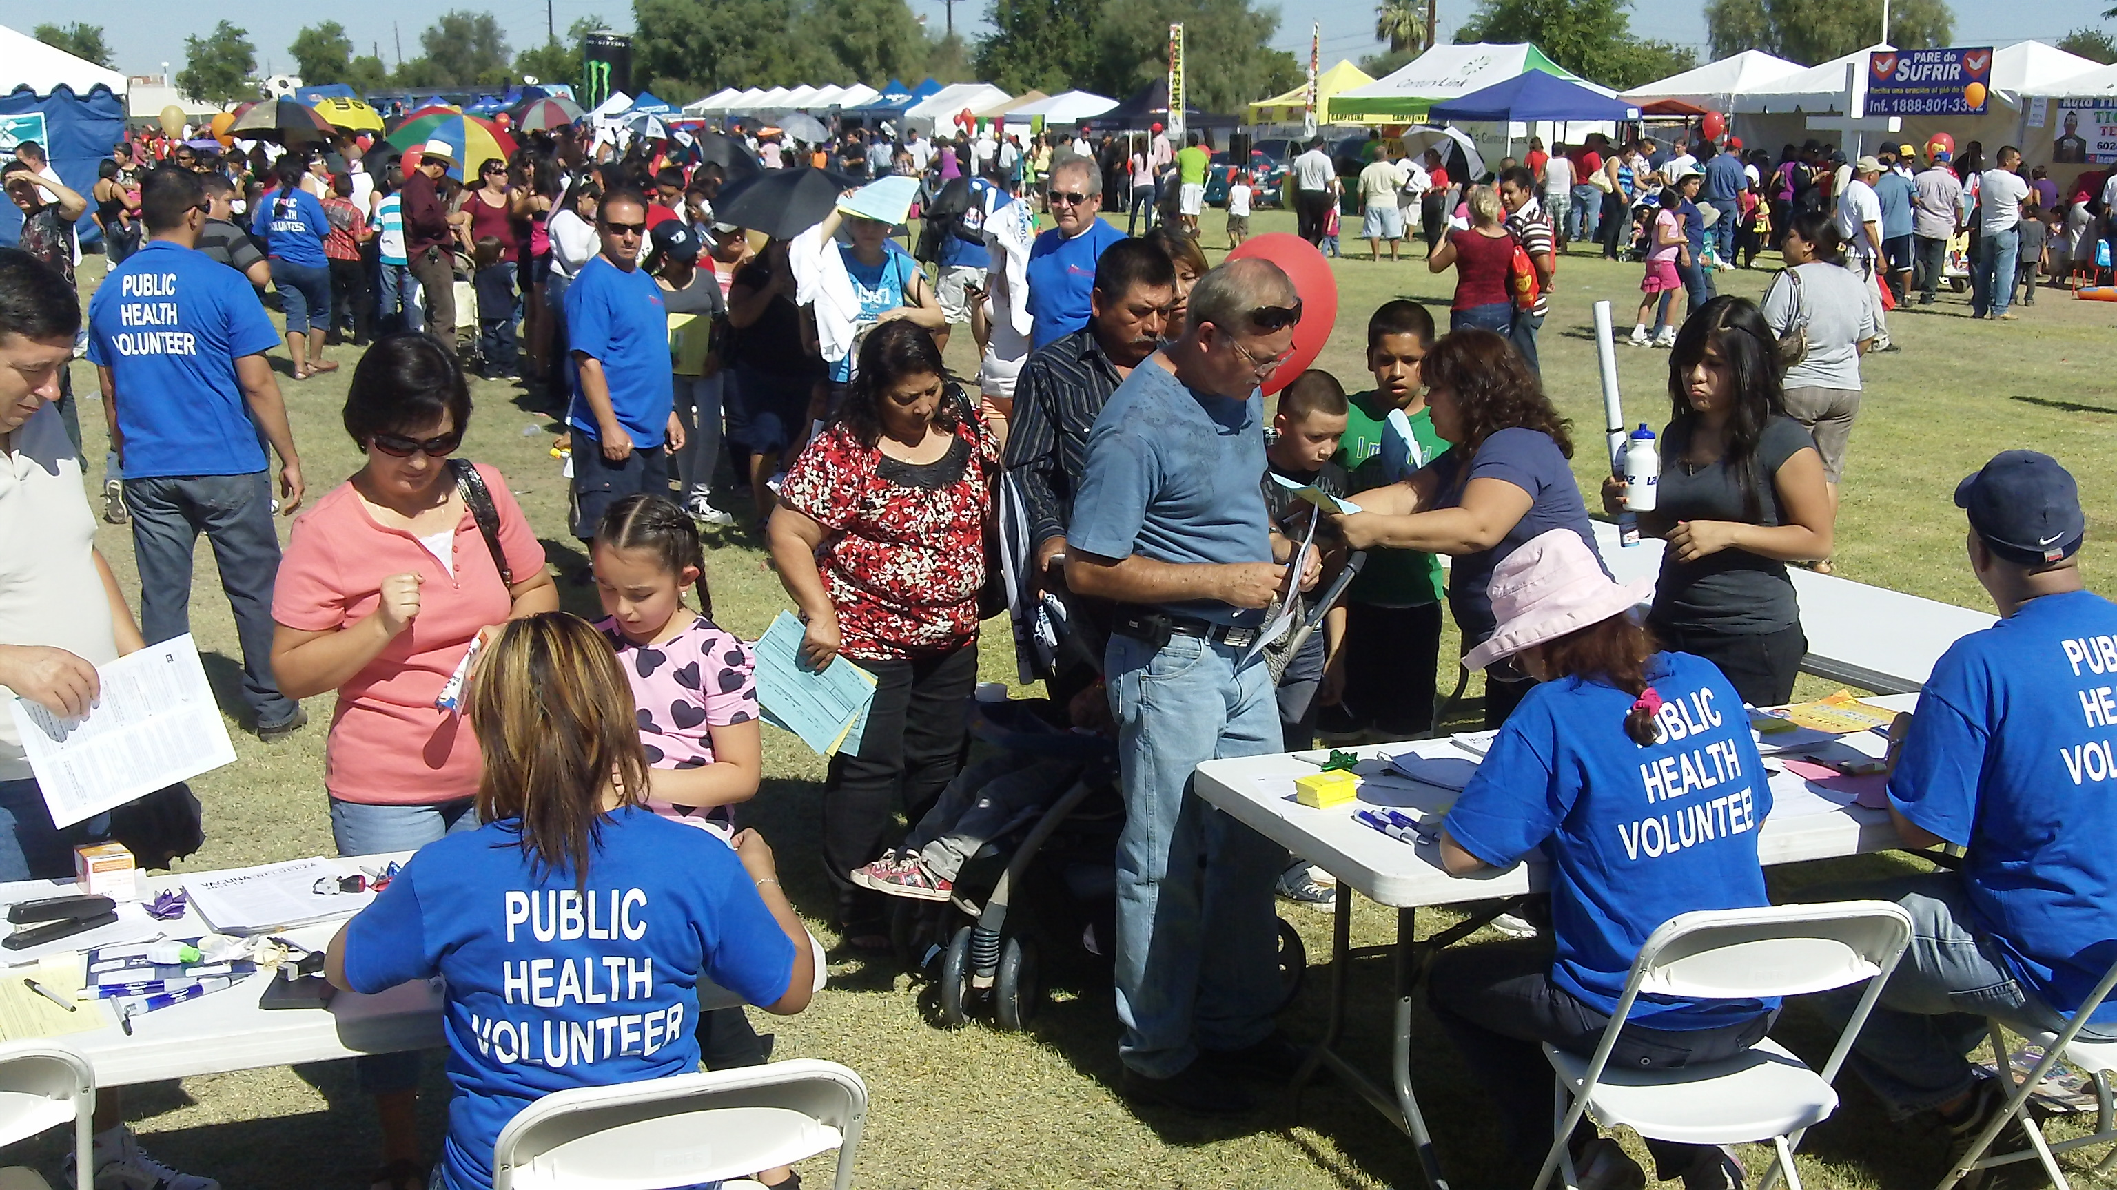
Business As Usual?

Slide 26
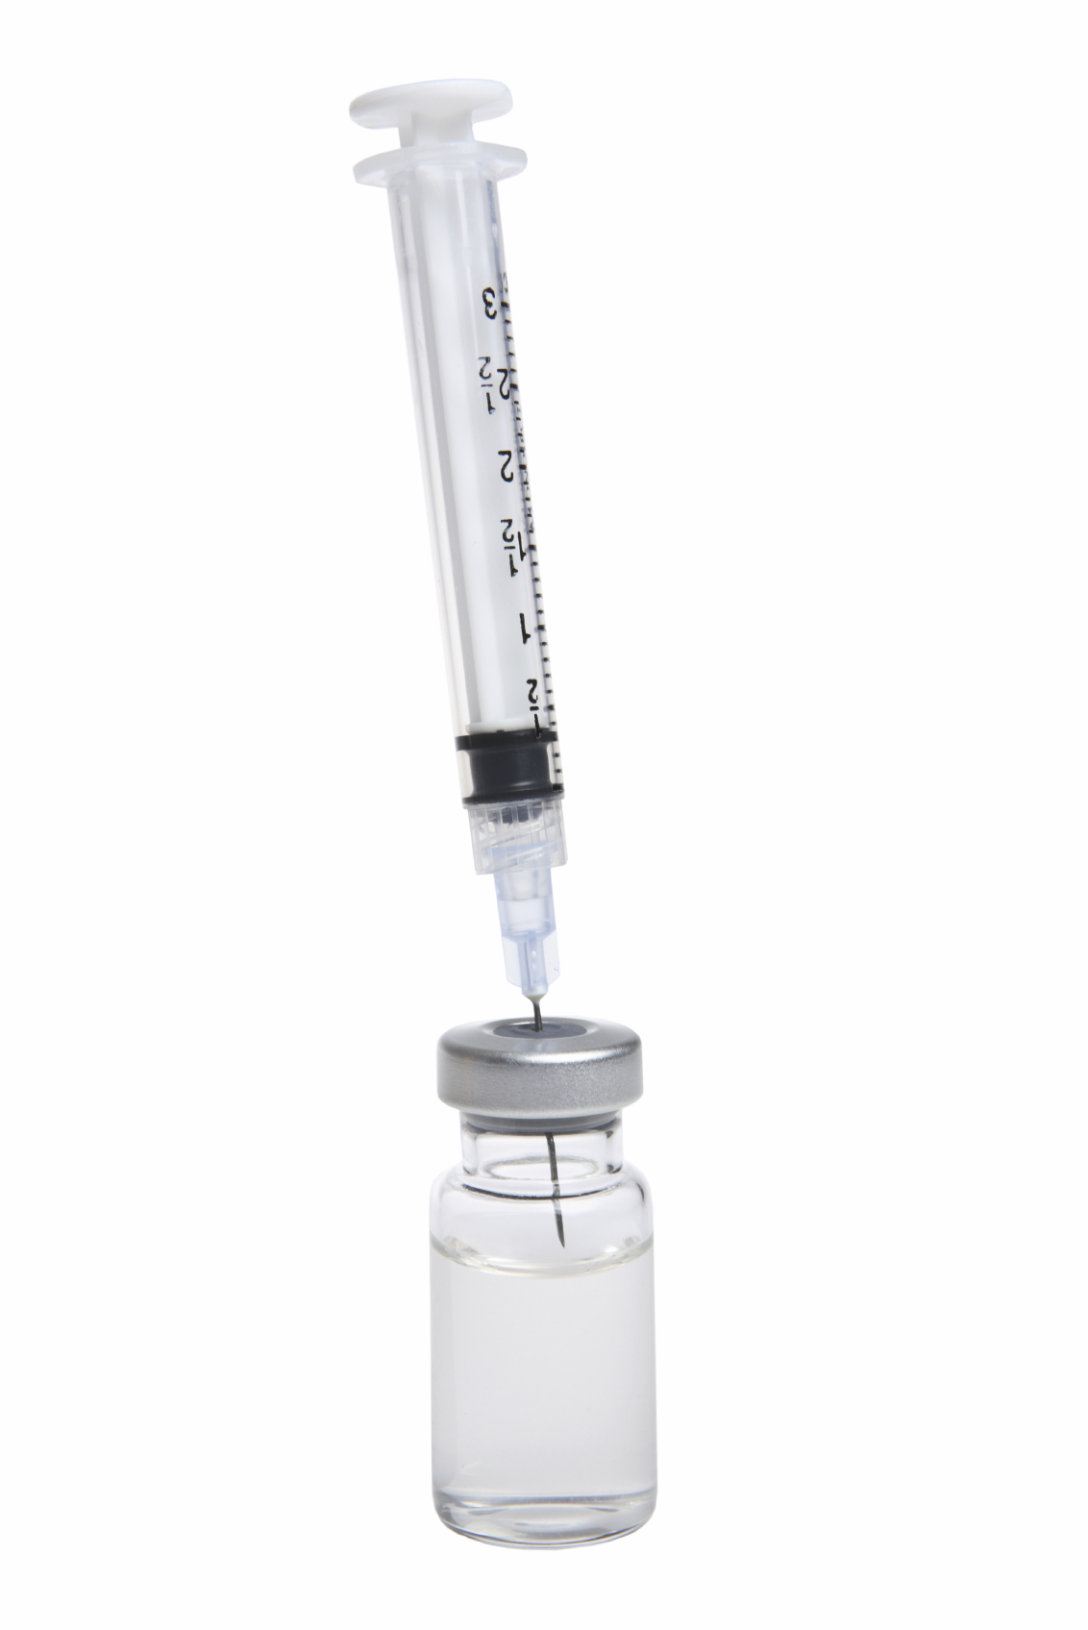
Private Billing Workflow
CDH
Administers vaccines
TAPI
Verifies, records and bills administration fees
TAPI
Post paid claims and reviews denied claims
Health Plans
Review the claims

Slide 27
Coalition Approach
Ongoing system and policy changes provided for public health billing:
…not just to provide billing services. TAPI is working to…
  Advocate for changes
  Contract negotiations for all partners
  Track monthly numbers for pubic health trends
  Publish monthly reports
  Provide yearly financial audit of funds
  Develop billing module in ASIIS

Slide 28

Coalition Approach
Ongoing system and policy changes provided for public health billing:
…not just to provide billing services. TAPI is working to…
  Explore statewide buying groups
  Train offices on immunization best practices
  Introduce legislation for mandatory reimbursements
Provide CME Programs for docs
Provide training for offices and health departments
Provide ongoing stakeholder updates

Slide 29
Cost of Public Health
Public health is providing medical services to the community
Public health shouldn’t have to use public funds to provide a service that has already been paid for:
        Private plan premiums
        Medicaid funds

Slide 30
The cost of running the program
3 FTE Data Entry Clerks $62,400
  Required to process 2,000-2,500 claims per month
Billing Claims Manager $40,000
  Provides quality control for claims
  Collect data for monthly reporting
  Upload batched claims to Availity
  Contact for health plan claims division follow up
  Resubmission of denied claims
ERE at 16% for direct project staff $16,384
Billing Software system (Leonardo MD) $24,000
Office Space and Storage $20,000
IT Support including data storage $15,000
Computers, equipment, office supplies $5,000
Project Support Expenses $30,000
  HR Services
  Project finance and reconciliation
  Annual audit
  Reimbursement negotiation
  Health plan annual contract negotiation
  Health plan engagement
  Assessments
Total $212,784

Slide 31
Private Billing Company vs Coalition
We are currently working with a consultant to do an in-depth cost analysis by month and season.
They are doing interim billing during the analysis in order to get a comparable time study
For data entry and claims submission and follow up- $223,000
Work together!

Slide 32
Recommendations
Consolidate resources and effort into state wide system
Consider National group for vaccine purchase and contracting
may not need to be credentialed as a public health department
No does not mean no! Instead of health plan contracting try EPSTD coordinators, quality control divisions and the medical Directors.
Get help! And be helpful!

Slide 33
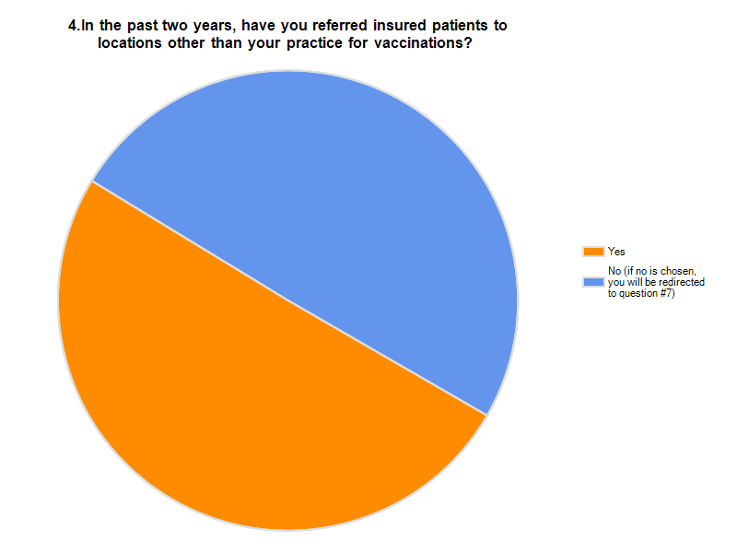
Next Steps
Secure favorable contracts with Private Health Plans
Expand services to other counties
Explore a private vaccine stock program
Reimbursement Legislation

Slide 34
The Big Questions…
Did we make our goal?
Did we make $1 more than we had?
Did we develop a sustainable program?

Slide 35

MCDPH/TAPI generated
$851,573
in administration fees
$538,943 has gone to Maricopa county for nurses and education programs

Slide 36
For every $1 spent
$2.23 is generated
55% profit on investment
$1,660,000 in claims have been submitted but many have been denied payment or payment was reduced

Slide 37


Slide 38
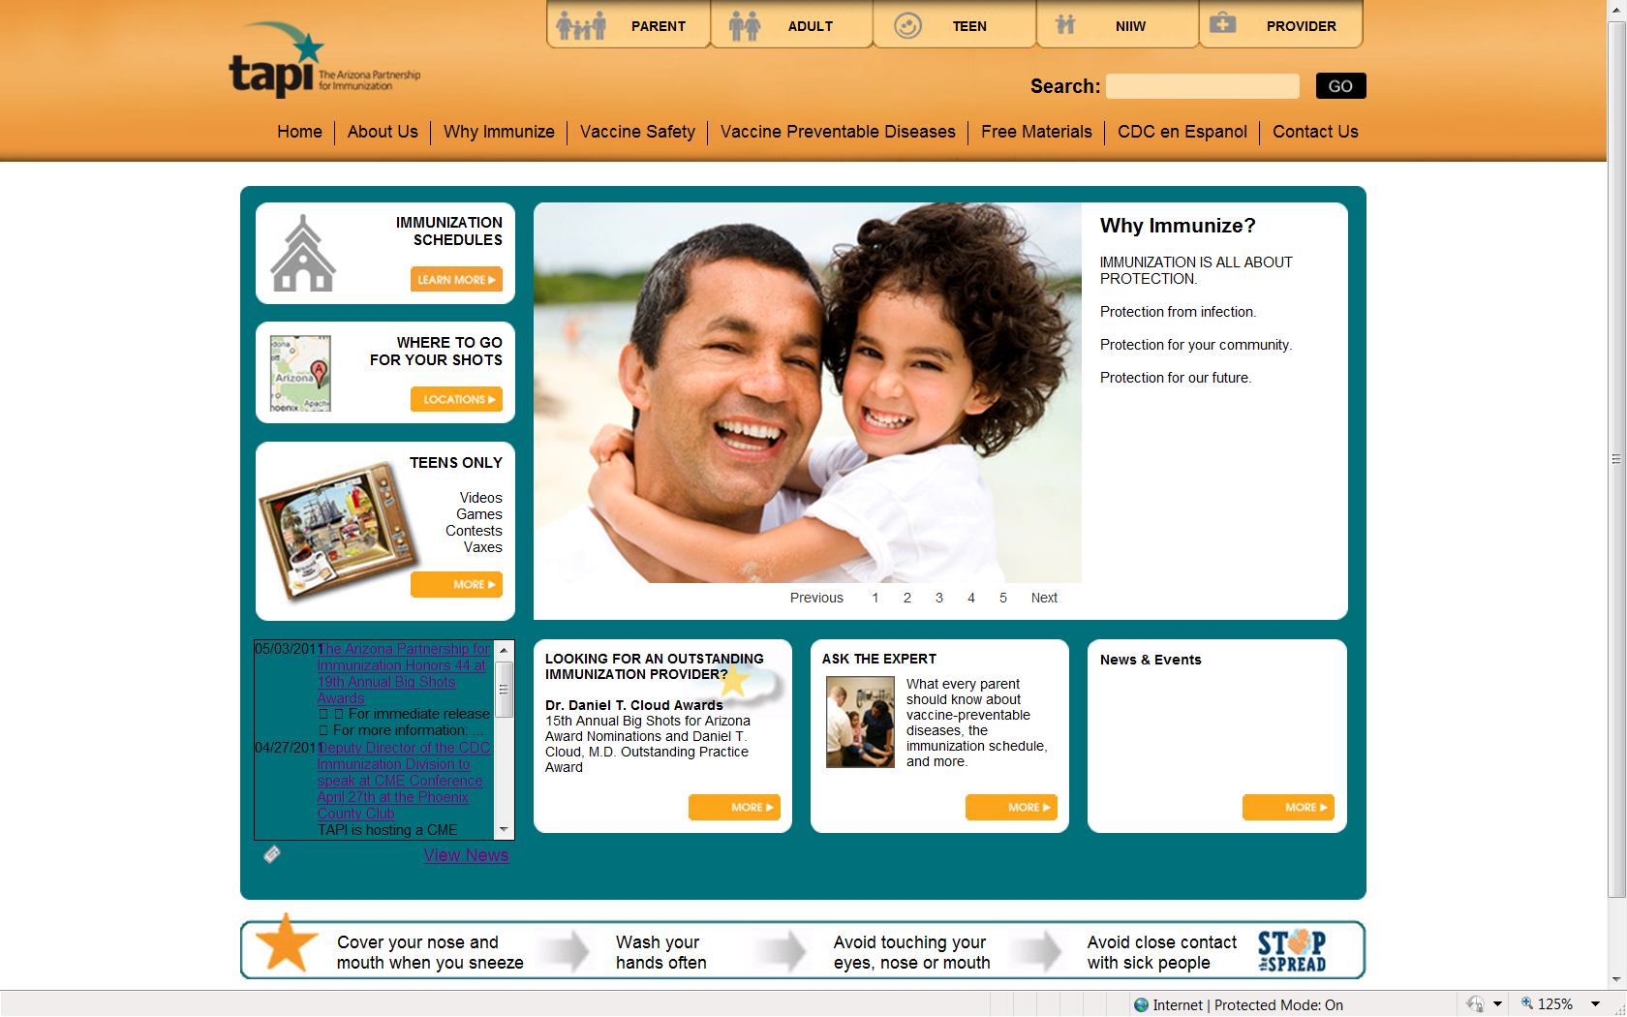

Slide 39
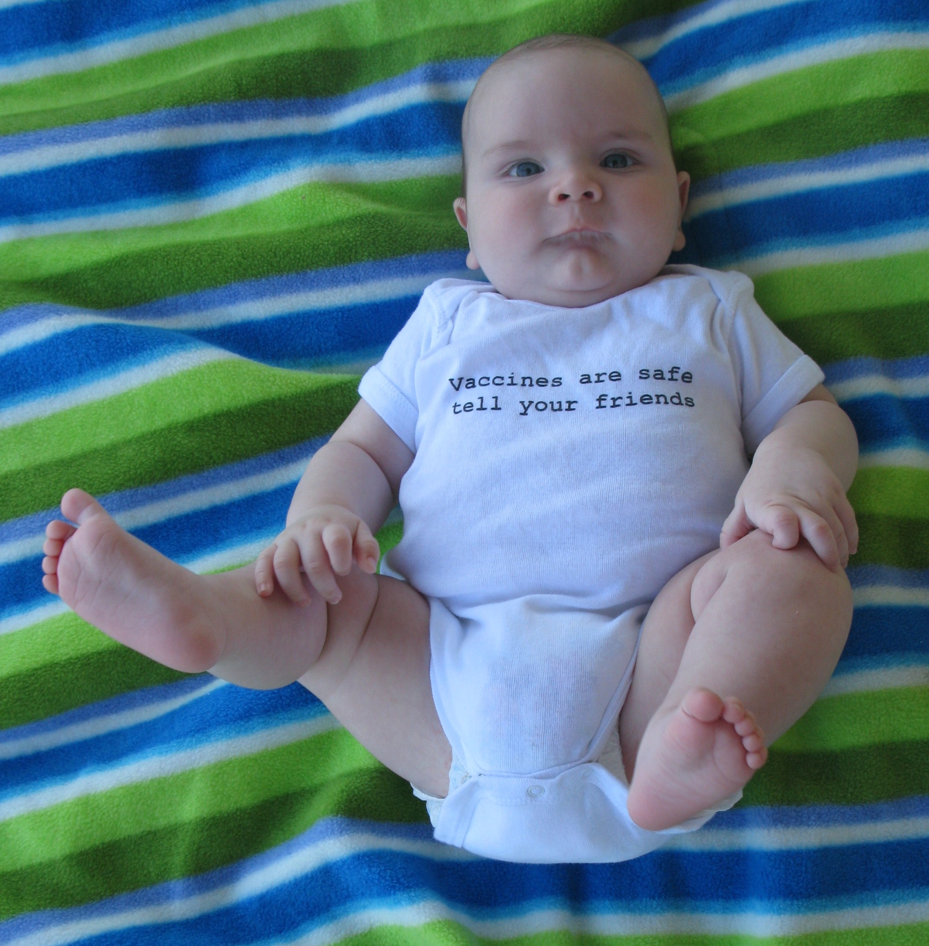
Jennifer Tinney
Program Manager
480.580.3584 mobile
602.288.7568 main office
jennifert@aachc.org
700 E. Jefferson Street, Suite 100
Phoenix, AZ 85034
whyimmunize.org

