Slide 1






Whining About Social Media
Presented by
Dawn Crawford - @SocMediaRckStr
Social Media & Communications Consultant

Slide 2









Full service communications agency that works exclusively with nonprofits & public health departments across the country
10 years of dedicated healthcare nonprofit experience + 7 years of corporate advertising experience
Bring us your problem and we’ll solve it
Clients, Experience & Affiliations

Slide 3
What Do You Want to Get Out of this session?

Slide 4
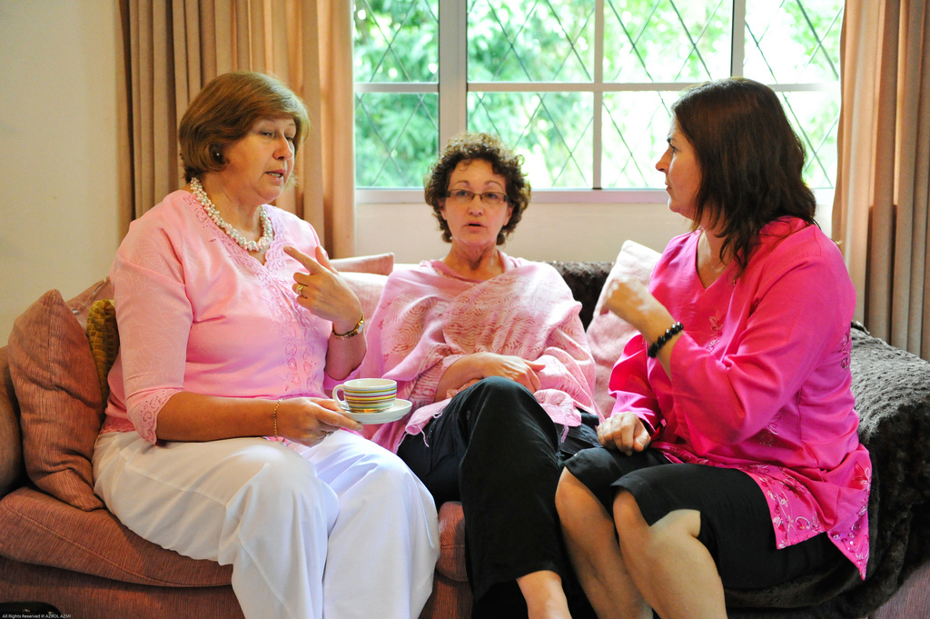
Social Media is a Conversation

Slide 5

Social Media is a Relationship
http://www.flickr.com/photos/eelssej_/394781835/sizes/z/in/photostream/

Slide 6
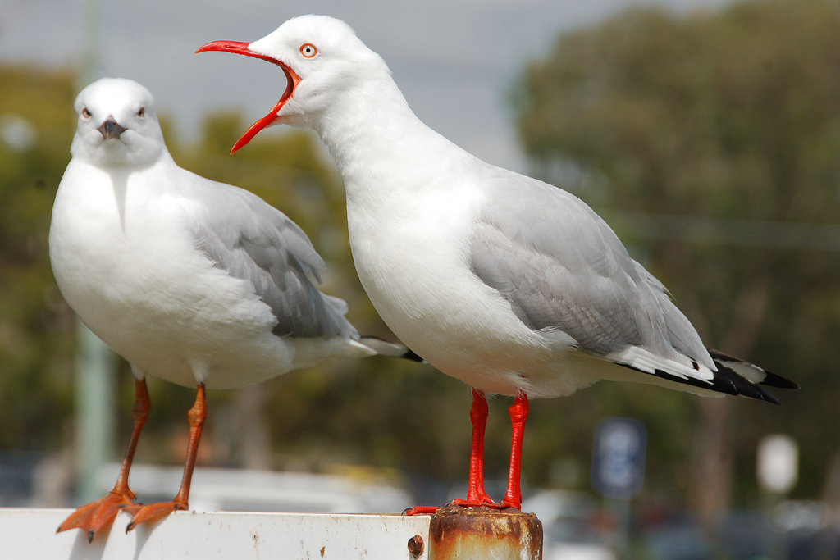
Do NOT Be This Gal
http://www.flickr.com/photos/mythoto/5064380001/sizes/l/

Slide 7
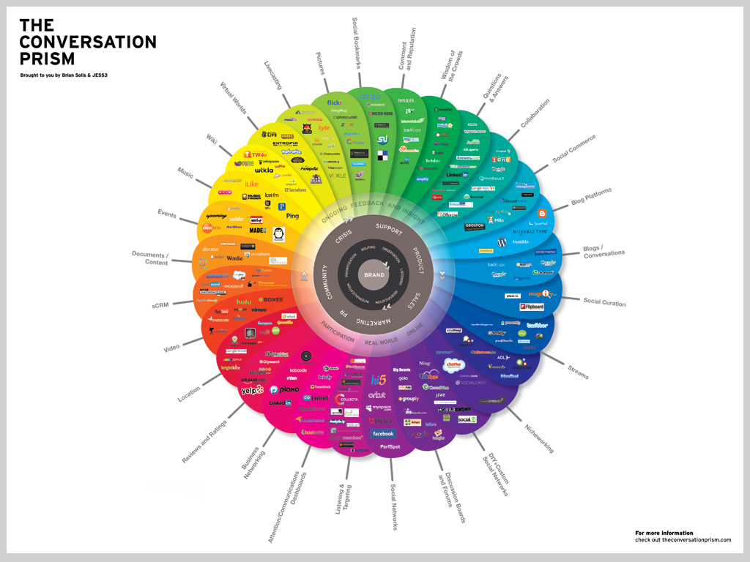

Slide 8

Create a page, not a group
Come “home” to Facebook
Update daily with news, events, etc.
Use lots of visuals – photos & videos are gold
Rock Stars:
  American Association of Long-Term Care Nurses - facebook.com/AALTCN
  Vaccinate Your Baby - facebook.com/VaccinateYourBaby
  The Arizona Partnership for Immunization

Slide 9

Repost from Facebook
Use as a giant news feed
Get on VIPs radar
Rock Stars
  One - @ONECampaign
  United Nation’s Shot@Life - @shotatlife
  Colorado Children’s Immunization Coalition - @immunizecokids

Slide 10

Create a collaboration space for professionals
Make a company page
Form a group for members
Rock Stars:
  AARP
  American Society for Pain Management Nursing (ASPMN)

Slide 11

Video is the next social media revolution – be ready for it!
Showcase your employees, doctors, patients, and partners
Rock Stars
  PKIDs - youtube.com/user/PKIDsOrg
  Families Fighting Flu - youtube.com/user/FamiliesFightingFlu

Slide 12
New Kids on the Block
Pinterest.com
Visual Social Bookmarking
Instagram - iPhone & Droid App Store
Photo mobile social network
Only on Apple and Droid products
plus.google.com
Happy, beautiful images
Examples: AARP, Autism Science Foundation
Examples: Autism Science Foundation, UNICEF
Google's answer to Facebook + Twitter
8 Million Users
Examples: Amnesty International, Malaria Museum

Slide 13







Find Your Mix
News | X | X | X |  |  |  | X
Photos | X | X |  |  | X | X | X
Videos | X | X |  | X | X |  | X
Events | X |  | X |  | X |  | X
Information Sharing | X | X |  |  |  |  | X
Builds Trust | X | X | X | X |  |  | X
More Women | X | X |  |  | X | Unknown | Unknown
Lots of Interaction | X | x |  | x | X | X | x

Slide 14
This is Important…

Slide 15
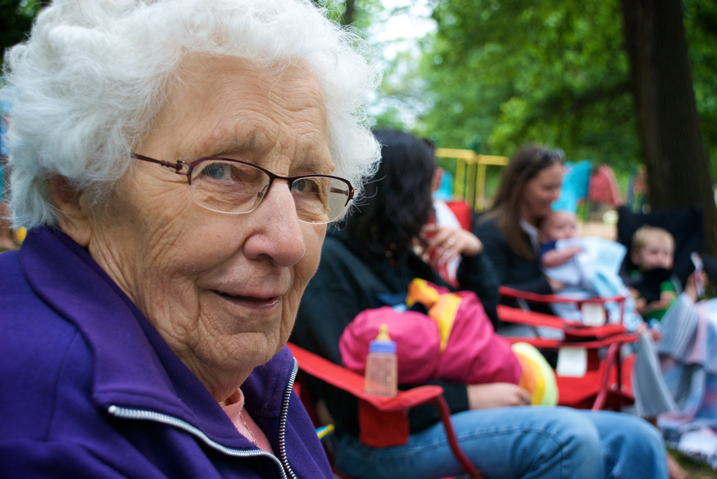
iChris

Slide 16
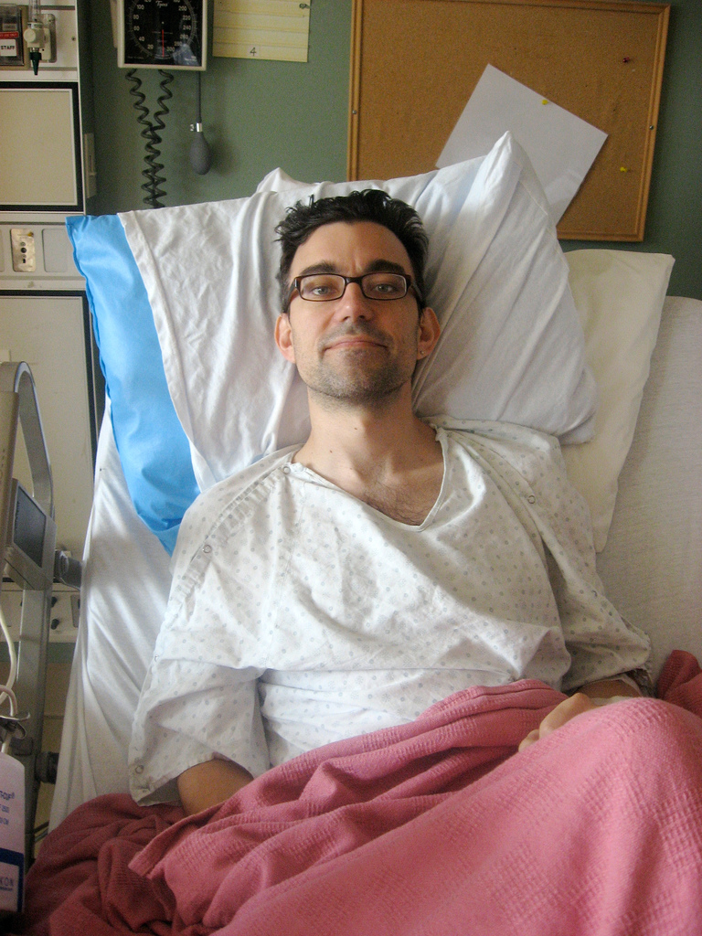
penmachine

Slide 17

paparutzi

Slide 18
this is important work

Slide 19

Passion is Infectious
http://www.flickr.com/photos/krystalt/5248185017/sizes/l/

Slide 20

Dawn Crawford
bcdcideas.com
dawnacrawford@gmail.com
720-231-1930
@SocMediaRckStr

