Slide 1
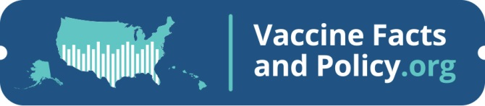



A Comprehensive Database of
U.S. Immunization Information
Katelyn Wells, PhD
AIM Research and Development Director

Slide 2

Thank you to
for initial funding support.

Slide 3

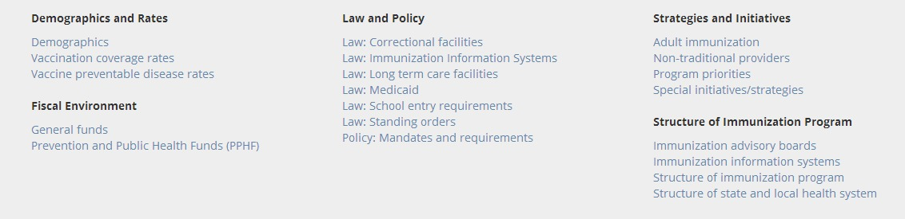
Overview: Purpose
Collect and catalog information that characterizes the immunization environment and infrastructure of all 64 jurisdictions
Provide easy access to information on a searchable website
Describe immunization programs for variety of users
(stakeholders, providers, policymakers, legislators, industry, consumers)

Slide 4
Benefits
      Access information on searchable website
      Find information in one place
          - National Data (e.g., IISR, NIS, Census)
          - Laws/Statutes
          - AIM Surveys
          - Partner Surveys
      Identify immunization program characteristics/activities
      View data in table or map form
      View aggregate responses by state, city, or territory
      Save and print reports

Slide 5
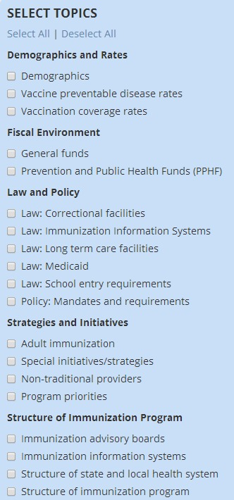
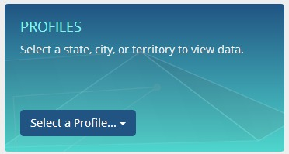
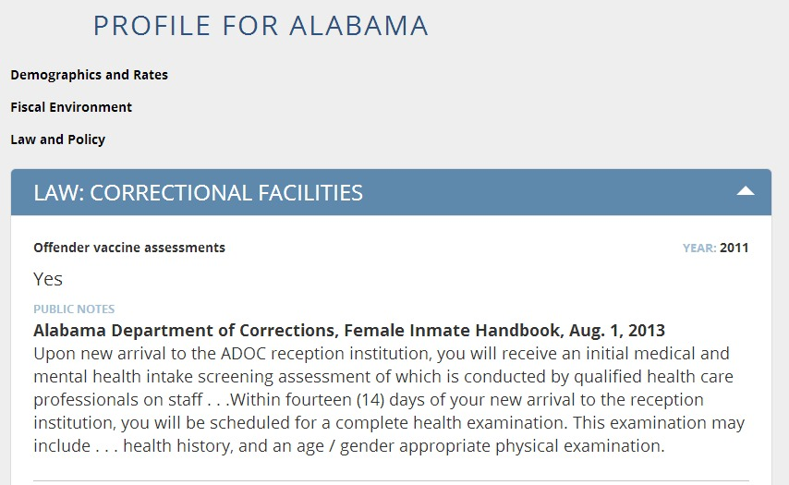
Key Features:
Printable Reports by Jurisdiction
Notes:
Key features-
Select a state
Select what information to include in the profile
Print and/or save as a pdf

Slide 6
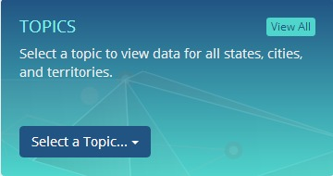
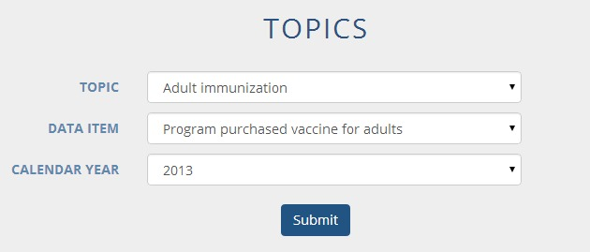
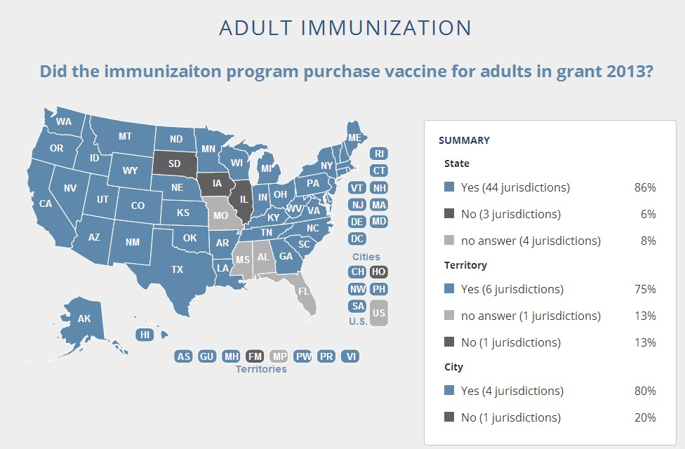
Key Features:
Printable Reports by Topic

Slide 7
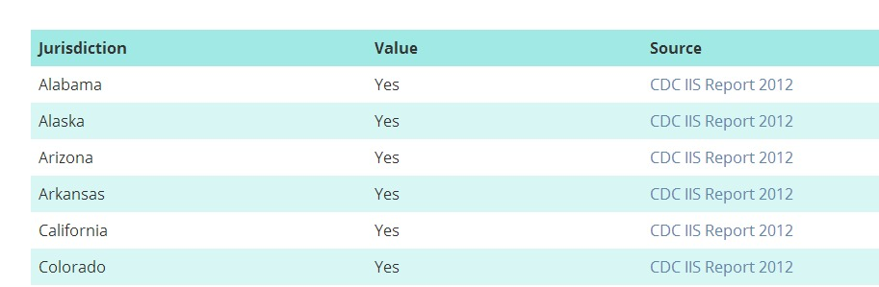
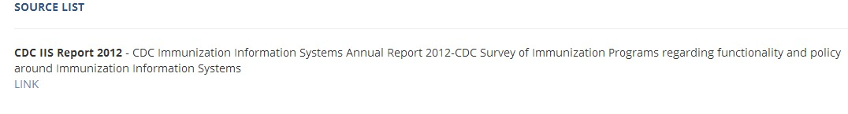
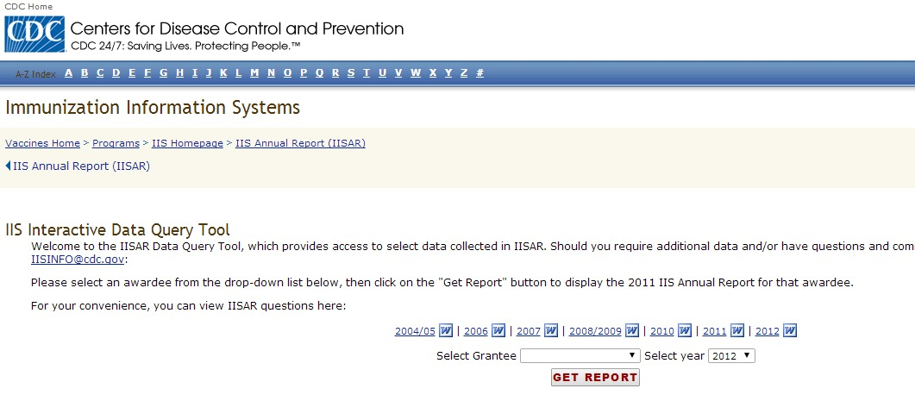
How is the data sourced?

Slide 8
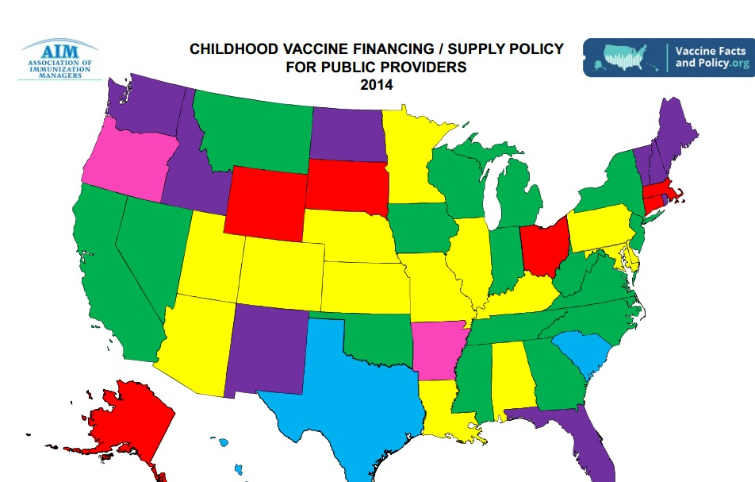
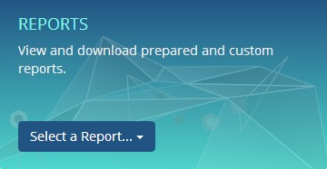
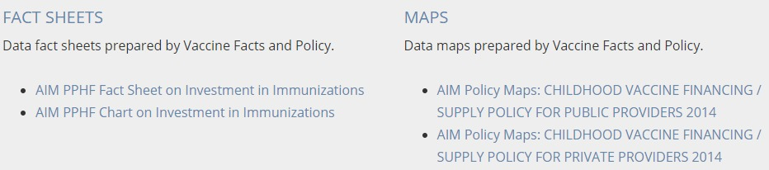
Key Features: Reports

Slide 9
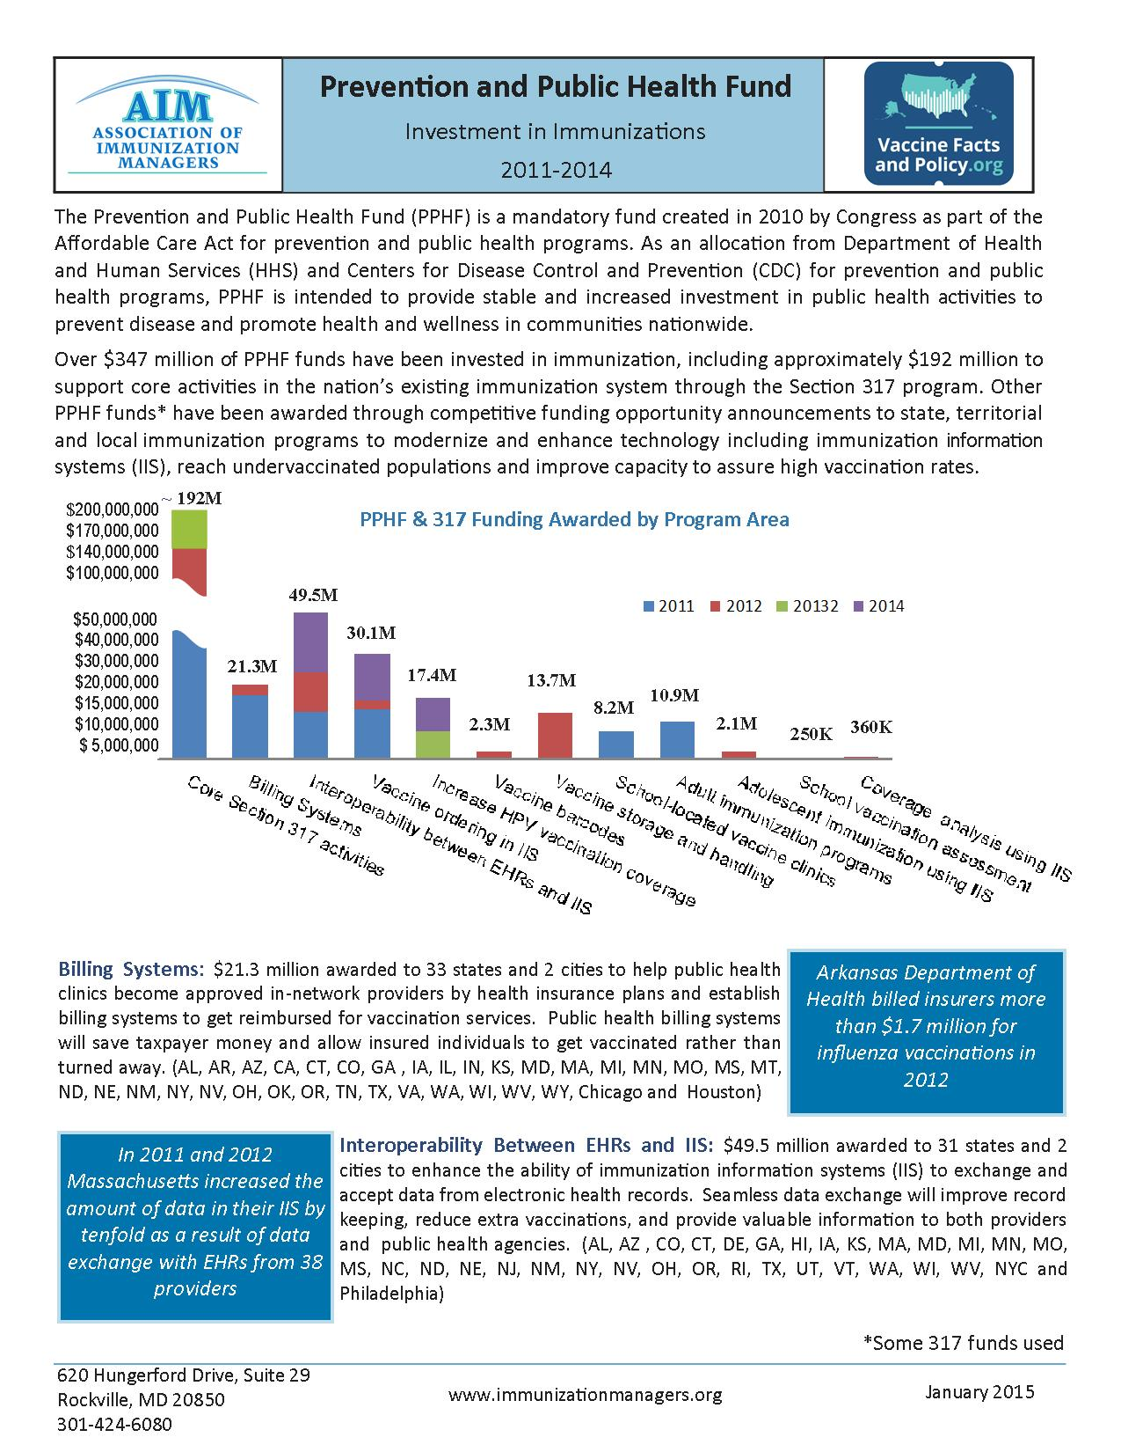
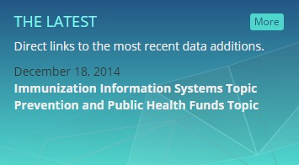
Key Features: Latest Updates

Slide 10
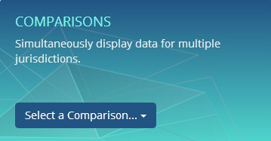
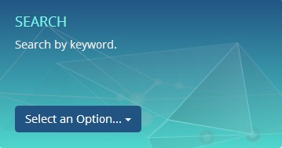
Key Features:
Under Development

Slide 11
Next Steps
Identify Funding – No Funding as of 1/2015
Update Data
  IAC maps
  GWU law review
  2014 AIM annual survey
Expand Law Review and Data Categories and Topics
(e.g., Adults, Adolescents, HPV)
Improve Website Functionality
  Comparison and custom reports
  Longitudinal data
  Search
Expand Partnerships
  Include relevant data from partner surveys (CDC, AIRA, ASTHO, etc.)
Create Reports Utilizing the Data
(issue briefs, manuscripts fact sheets, maps, etc.)

Slide 12
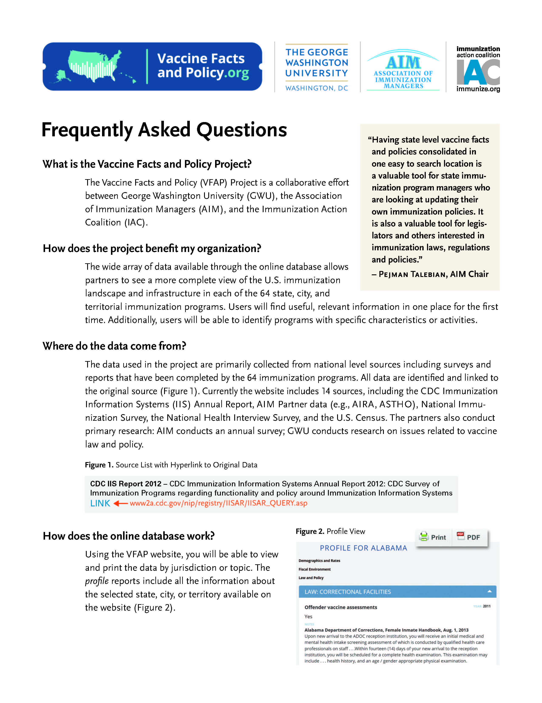
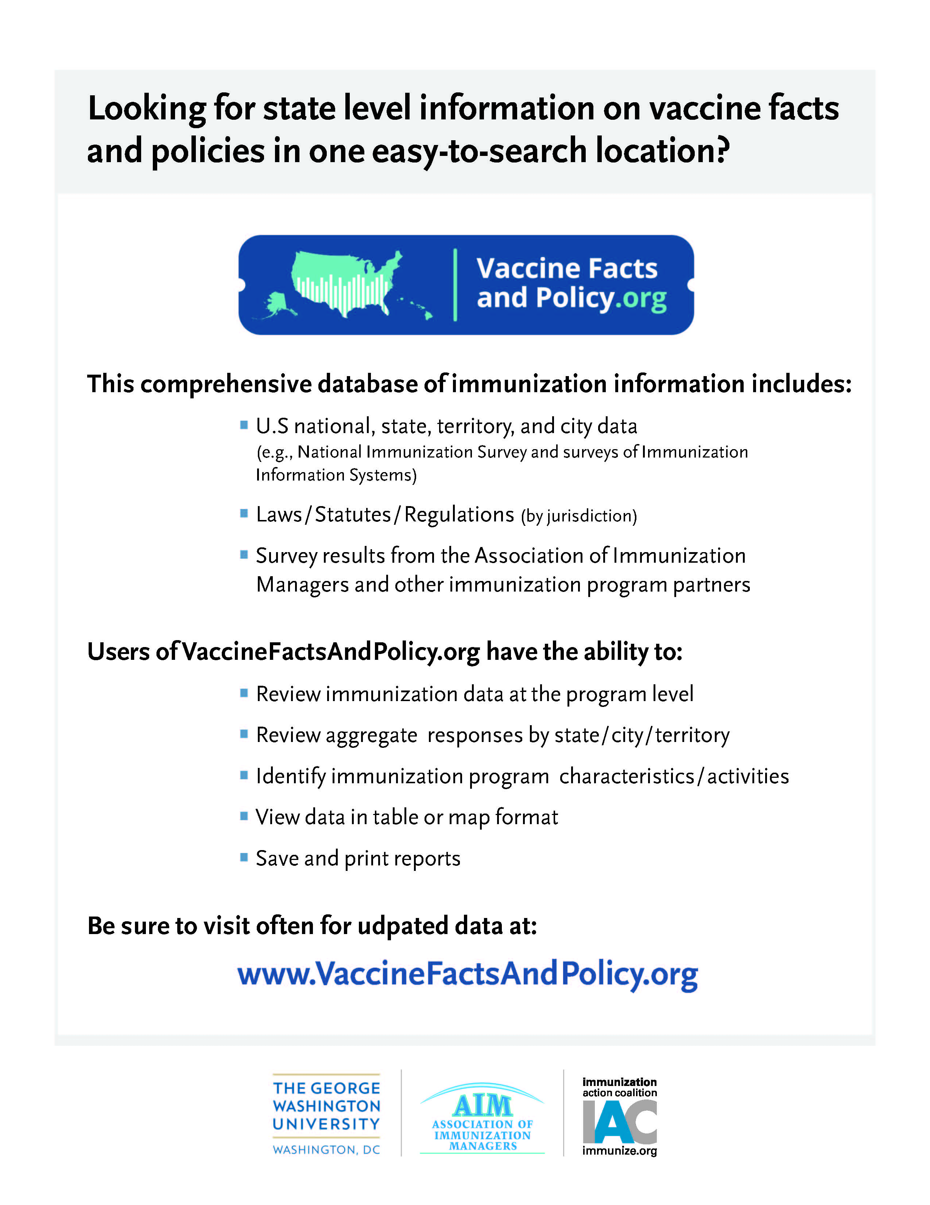
Help us spread the word! email – newsletters – websites – meetings- social media

Slide 13
Questions?
info@vaccinefactsandpolicy.org

